Slide 1
A Completely Serious Overview of Network Performance for Scientific Networking
Jason Zurawski, Science Engagement Engineer
ESnet
Focused Technical Workshop
Lawrence Berkeley National Lab, Berkeley, CA
July 18th 2013

Slide 2
Outline (Completely Serious)
Endgame – Efficient networks to support science
Use Case
Expectations & Realities
Problem Definition
Solution Space
Conclusions
© 2013 Muppet Wiki

Slide 3
Endgame = Scientific Network Use
What we have seen so far yesterday, and today:
Network Infrastructure
Storage and Processing
Workflow
Applications
What we are missing:
Preparing for the worst, e.g. sometimes it just doesn’t work
Addressing problems (deliberate and non-deliberate)
“Festivus”
e.g. data movement/network design strategies for the rest of us – may involve feats of strength and airing of grievances

Slide 4
Outline
Endgame
Use Case – Meet our actors and action
Expectations & Realities
Problem Definition
Solution Space
Conclusions

Slide 5
Use Case = End to End Exchange
Alice & Bob are collaborators
Experts in their field
Physically separated (common)
Rely on networks, but are not IT experts (common & expected)
They know their local IT staff. May also have an adversarial relationship with them (e.g. Alice and Bob are ‘troublemakers’ since they use the network, and expect it to work)
Alice & Bob want to embark on a new project
Instrumentation @ one end, processing/analysis @ the other
Keep in mind they know about the science, not about the technology in the middle
Use infrastructure they are comfortable with, perhaps cobbled together by local support staff

Slide 6
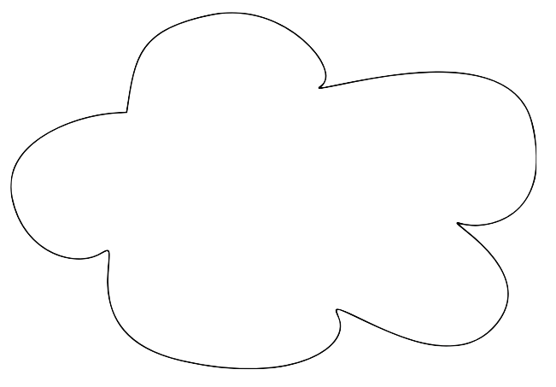
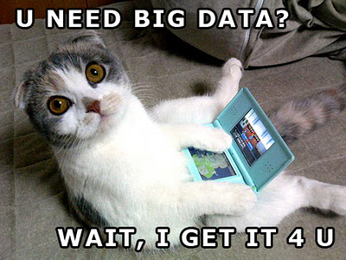
Meet Alice & Bob - They are Science Cats
HAI, I CAN HAZ DATA?
K THX BAI
INTERNETS
© 2013 Susan's School Days
© 2013 icanhascheezburger.com
MOAR DATA 4 U

Slide 7
Outline
Endgame
Use Case
Expectations & Realities – What could possibly go wrong?
Problem Definition
Solution Space
Conclusions
© 2013 funnyasduck.net

Slide 8
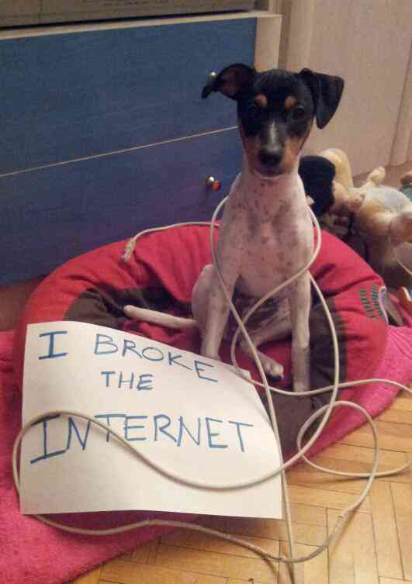
Expectations & Realities
"In any large system, there is always something broken.”
Jon Postel
Modern networks are large and complicated
Many users will encounter unforeseen (and therefore challenging) situations:
Upgrading networks breaks them (loss of configuration, etc.)
Synergy between the new and the old
Statistical anomalies, e.g. that 7 year old interface will stop working eventually…
Mitigating the risk can be done in a number of ways:
Analysis and alteration to architecture
Careful thought to security/data policies in target areas
© Dog Shaming 2012
Integration of software designed to exercise the network, and alert/visualize

Slide 9
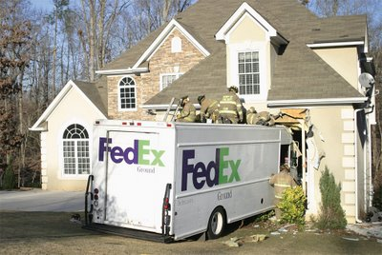
Meet Alice & Bob; Sad Reality
HAI, I CAN HAZ DATA?
I CAN HAZ TECH SUPPORT?
I CAN HAZ FEDEX?
SOOO SLOOOW!
INTERNETS
© 2013 Susan's School Days
© 2013 icanhascheezburger.com
MOAR DATA 4 U
© 2013 Renee Richardson photography
© 2013 Berkeley Breathed

Slide 10
“The Network Is Working Fine”
Trouble prompted a call to support (e.g. know when you are in too deep)
The response can be frustrating (we all have been there…)
The engineers look at magic (and secret) monitoring tools, and tell you, firmly, that things are as they should be.
In fairness – the network *may* be fine locally. e.g. We don’t see the signs of stress for the pieces we control
In reality we need ‘end to end’ visibility, its what you experienced after all

Slide 11
Identification of Problems
Use Case = End to End
All collaboration is multi-domain, which implies you need to care about how others are running their networks as well
Many problems may fall between the cracks as the RTT increases (N.B. work by many, including M. Mathis)
Two behaviors that need adjustment:
“Not My Network, Not My Problem”
Patience of Researcher
Notes:
Note that there was an attempt here to ‘complain’, and then a workaround.

Slide 12
Outline
Endgame – Efficient Use of the Network to Support Science
Use Case
Expectations & Realities
Problem Definition – More than meets the eye
Solution Space
Conclusions

Slide 13
Abstraction Helps & Hurts
INTERNETS
Notes:
Need to look at our environment from different angles
Networks are large and complex, but well structured
The environment itself has mechanisms that can be used to address problems

Slide 14
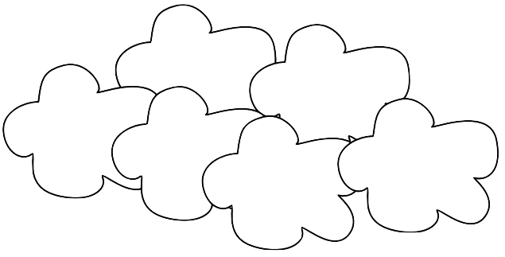
Abstraction Helps & Hurts
THEIR INTERNETS
OTHER INTERNETS
MY INTERNETS
MOAR INTERNETS
YOUR INTERNETS
??? INTERNETS
Notes:
Need to look at our environment from different angles
Networks are large and complex, but well structured
The environment itself has mechanisms that can be used to address problems

Slide 15
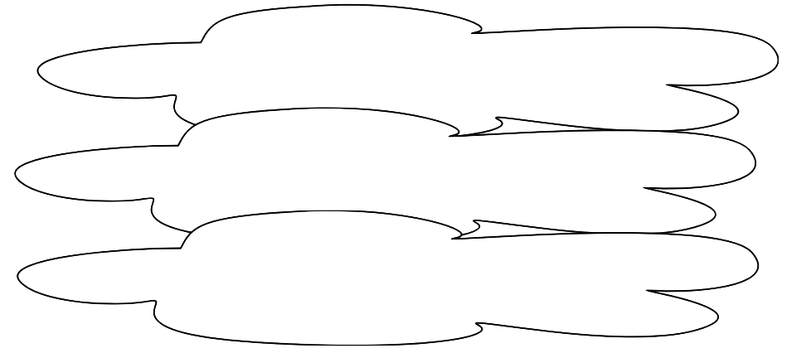
Abstraction Helps & Hurts
© 2013 University of Washington
Notes:
Need to look at our environment from different angles
Networks are large and complex, but well structured
The environment itself has mechanisms that can be used to address problems

Slide 16
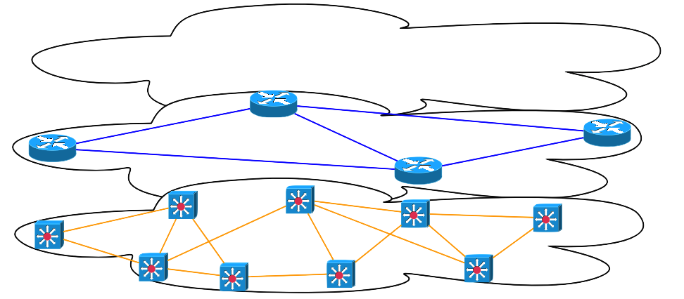
Abstraction Helps & Hurts
Protocols, Etc.
Notes:
Need to look at our environment from different angles
Networks are large and complex, but well structured
The environment itself has mechanisms that can be used to address problems

Slide 17
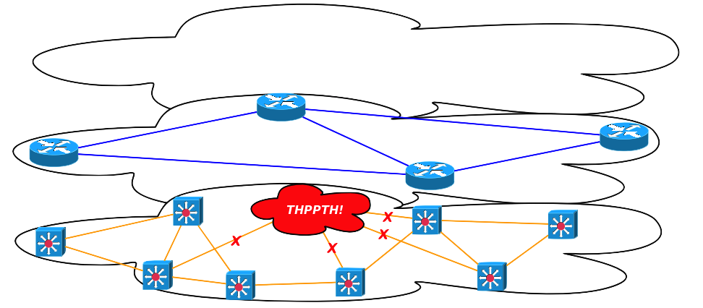
Failure in the Layers
Protocols Adjust to Failure Transparently
Severed Connections Are Easy to Find/Fix
“Slow” Connections are Harder…
Redundancy Helps With Redundancy
IM DROPN UR
PACKETS LOL

Slide 18
Outline
Endgame – Efficient Use of the Network to Support Science
Use Case
Expectations & Realities
Problem Definition
Solution Space – It’s not as bleak as it seems
Conclusions

Slide 19
Solution Space
Basic idea:
Architectural changes
Solution for Monitoring/Emulation of User Behavior
Workflow Analysis/Adoption of New Tools (but we have heard that part already)
Architecture
Split out enterprise concerns from data intensive ones
Directed security policies, instead of blanket enforcement
E.g. the Science DMZ
Monitoring:
Dedicated resources at different vantage points in the network
Running some standard and useful types of measurement
Integrated with tools that allow you to see/hear when a problem arises

Slide 20
Science DMZ Overview
Significant commonality in issues encountered with science collaborations … and similar solution set
The causes of poor data transfer performance fit into a few categories with similar solutions
Un-tuned/under-powered hosts
Packet loss issues
Security devices
A successful model has emerged – the Science DMZ
This model successfully in use by CMS/ATLAS, ESG, NERSC, ORNL, ALS, and others
The Science DMZ is a blueprint for network design.
Not all implementations look the same, but share common features
Some choices don’t make sense for everyone, caveat emptor

Slide 21
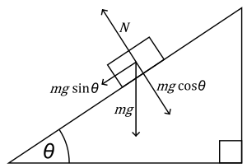
The Science DMZ in 1 Slide
Consists of three key components, all required:
“Friction free” network path
Highly capable network devices (wire-speed, deep queues)
Virtual circuit connectivity option
Security policy and enforcement specific to science workflows
Located at or near site perimeter if possible
Dedicated, high-performance Data Transfer Nodes (DTNs)
Hardware, operating system, libraries all optimized for transfer
Includes optimized data transfer tools such as Globus Online and GridFTP
Performance measurement/test node
perfSONAR
Details at http://fasterdata.es.net/science-dmz/
© 2013 Wikipedia
© 2013 Globus

Slide 22
Science DMZ – Simple Abstract Cartoon
Notes:
Note security policy control points

Slide 23
Perf-what?
Network Monitoring
E.g. everyone has some form on their network. Addresses needs of local staff for understanding state of the network
Would this information be useful to external users?
Can these tools function on a multi-domain basis?
Beyond passive methods, there are active tools.
E.g. often we want a ‘throughput’ number. Can we automate that idea?
Wouldn’t it be nice to get some sort of plot of performance over the course of a day? Week? Year? Multiple endpoints?
perfSONAR = Measurement Middleware

Slide 24
What is perfSONAR?
http://psps.perfsonar.net
perfSONAR is a tool to:
Set network performance expectations
Find network problems (“soft failures”)
Help fix these problems
All in multi-domain environments
These problems are all harder when multiple networks are involved
perfSONAR is provides a standard way to publish active and passive monitoring data
This data is interesting to network researchers as well as network operators
Notes:
Enables Federation
Service oriented
Designed with ‘multi-domain’ in mind
Brings together useful tools to address different needs
Several active and passive tools
Interface to configure regular testing
Diagnostic tools ready with ‘0 configuration’
Easy to install, easy to use
ISO image can be burned to CD/USB key
‘Wizard’ interface for configuration
Encouraging people to deploy ‘known good’ measurement points near domain boundaries
“known good” = hosts that are well configured, enough memory and CPU to drive the network, proper TCP tuning, clean path, etc.
Community Adoption
Over 600 instances seen world wide as of early May
20+ countries
100s of domains

Slide 25
World-Wide perfSONAR-PS Deployments: 572 bwctl nodes, 552 owamp nodes as of Jun ‘13

Slide 26
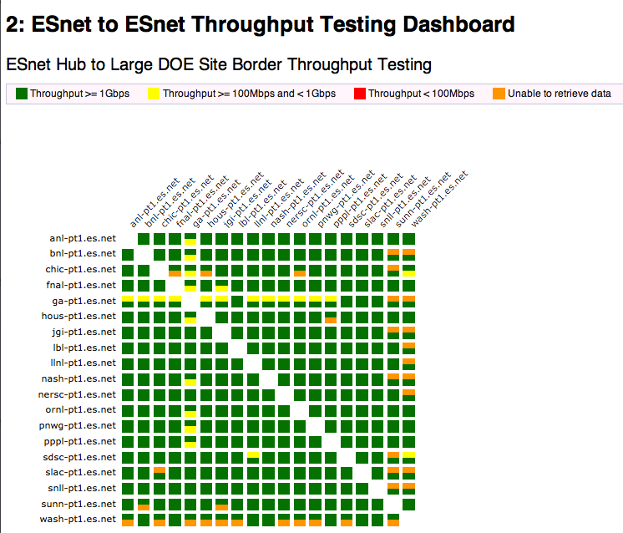
Visualizations & Alarms – Automation is the key http://ps-dashboard.es.net

Slide 27
One motivation for Science DMZ & perfSONAR models: Soft Network Failures
Soft failures are where basic connectivity functions, but high performance is not possible.
TCP was intentionally designed to hide all transmission errors from the user:
“As long as the TCPs continue to function properly and the internet system does not become completely partitioned, no transmission errors will affect the users.” (From IEN 129, RFC 716)
Some soft failures only affect high bandwidth long RTT flows.
Hard failures are easy to detect & fix
Soft failures can lie hidden for years!
One network problem can often mask others
Notes:
Random Packet Loss
Bad/dirty fibers or connectors
Low light levels due to amps/interfaces failing
Duplex mismatch
Small Router/Switch Buffers
Switches not able to handle the long packet trains prevalent in long RTT sessions and local cross traffic at the same time
Un-intentional Rate Limiting
Processor-based switching on routers due to faults, acl’s, or mis-configuration
Security Devices
E.g.: 10X improvement by turning off Cisco Reflexive ACL

Slide 28
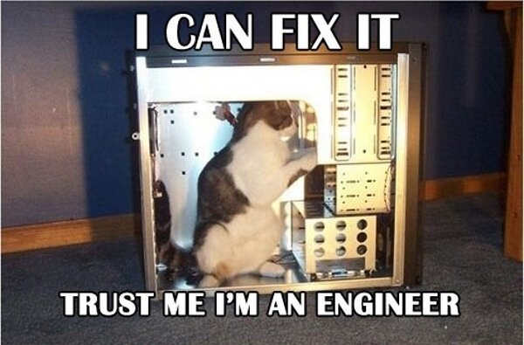
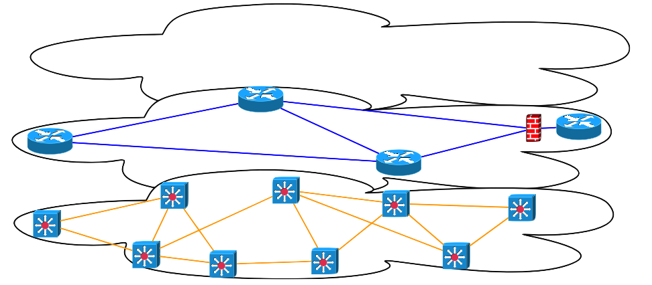
Affect of Broken Firewall on Traffic
© 2013 Clever Noob
© 2013 REDBUBBLE

Slide 29
Outline
Endgame – Efficient Use of the Network to Support Science
Use Case
Expectations & Realities
Problem Definition
Solution Space
Conclusions

Slide 30
Conclusions
Goals:
Efficient end to end use of the network, no matter the use case (bulk data movement to video)
‘Happy’ users & operators
Problems:
Network design may need work, sometimes things just break
How to find/fix the problems that are out there
Solutions
Architectural changes
Adoption of new solutions
Continued Conversation:
perfSONAR:
http://psps.perfsonar.net
perfsonar-node-users@internet2.edu
https://lists.internet2.edu/sympa/info/performance-node-users
Science DMZ:
http://fasterdata.es.net
sciencedmz@es.net
https://gab.es.net/mailman/listinfo/sciencedmz

Slide 31
A Completely Serious Overview of Network Performance for Scientific Networking
Questions?
Jason Zurawski – zurawski@es.net
http://www.es.net/
http://fasterdata.es.net/

