Slide 1
The perfSONAR Project at 10 Years: Status and Trajectory
Jason Zurawski - ESnet Engineering & Outreach
engage@es.net
GN3 (GÉANT) NA3, Task 2 - Campus Network Monitoring and Security Workshop
April 24th 2014
With contributions from S. Balasubramanian, G. Bell, E. Dart, M. Hester, B. Johnston, A. Lake, E. Pouyoul, L. Rotman, B. Tierney and others @ ESnet

Slide 2
Overview
Introduction
The Ghost of perfSONAR Past
perfSONAR Present
Use Cases
Future Directions & Unfinished Business

Slide 3
Overarching Motivation
Networks are an essential part of data-intensive science
Connect data sources to data analysis
Connect collaborators to each other
Enable machine-consumable interfaces to data and analysis resources (e.g. portals), automation, scale
Performance is critical
Exponential data growth
Constant human factors
Data movement and data analysis must keep up
Effective use of wide area (long-haul) networks by scientists has historically been difficult
Notes:
Human factors – attention span, ability to manage complexity
It is our hope that this work enables effective use of networking for science

Slide 4
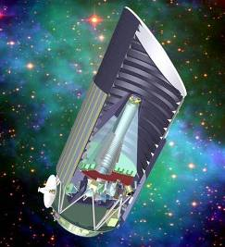
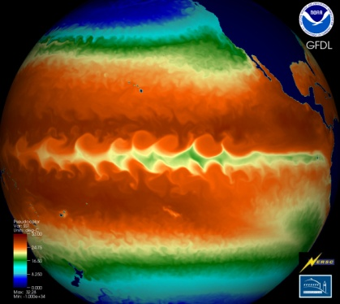
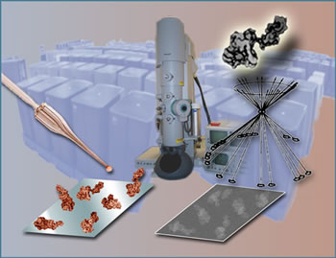
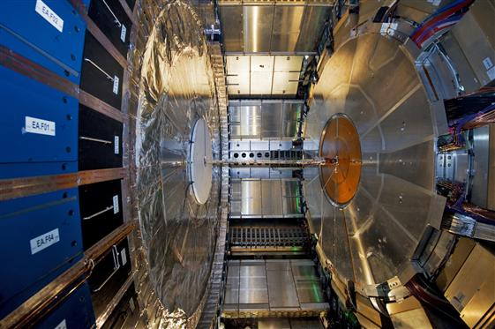
ESnet Supports DOE Office of Science
Notes:
This low-res map shows why most of our data flows terminate outside the national lab complex.
=-=-=-=-=-=-=-=-=-
ESnet - the Energy Sciences Network - is an SC program whose primary mission is to enable the large-scale science of the Office of Science that depends on:
Multi-institution, world-wide collaboration
Data mobility: sharing of massive amounts of data
Distributed data management and processing
Distributed simulation, visualization, and computational steering
Collaboration with the US and International Research and Education community
=-=-=-=-=-=-=-=-=-
ESnet connects the Office of Science National Laboratories and user facilities to each other and to collaborators worldwide
Ames, Argonne, Brookhaven, Fermilab, Lawrence Berkeley, Oak Ridge, Pacific Northwest, Princeton Plasma Physics, SLAC, and Thomas Jefferson National Accelerator Facility,

Slide 5
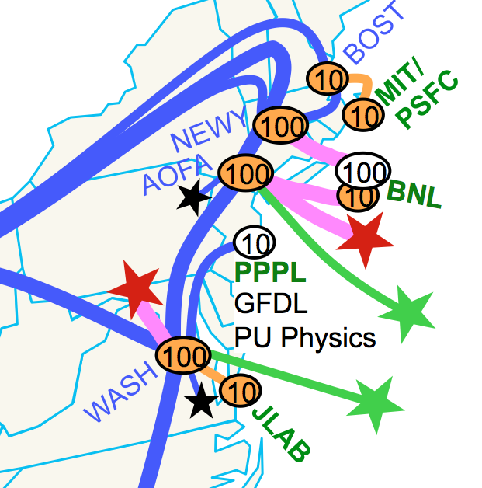
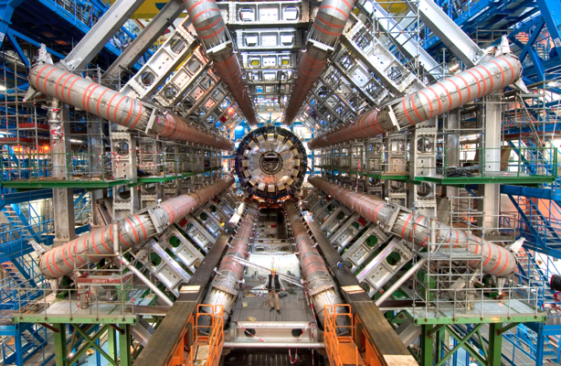
ESnet’s Vision
Scientific progress is completely unconstrained by the physical location of instruments, people, computational resources, or data.

Slide 6
The Central Role of the Network
The very structure of modern science assumes science networks exist: high performance, feature rich, global scope
What is “The Network” anyway?
“The Network” is the set of devices and applications involved in the use of a remote resource
This is not about supercomputer interconnects
This is about data flow from experiment to analysis, between facilities, etc.
User interfaces for “The Network” – portal, data transfer tool, workflow engine
Therefore, servers and applications must also be considered
What is important?
Correctness
Consistency
Performance
Notes:
If networks are so important, we need to make them useful

Slide 7
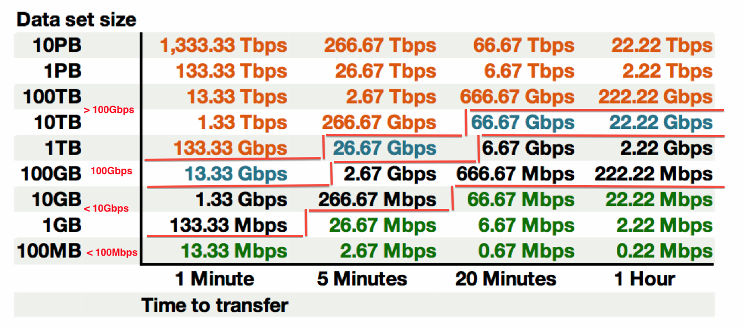
Sample Data Transfer Rates
This table available at:
http://fasterdata.es.net/fasterdata-home/requirements-and-expectations/

Slide 8
TCP – Ubiquitous and Fragile
Networks provide connectivity between hosts – how do hosts see the network?
From an application’s perspective, the interface to “the other end” is a socket
Communication is between applications – mostly over TCP
© 2013 icanhascheezburger.com
TCP – the fragile workhorse
TCP is (for very good reasons) timid – packet loss is interpreted as congestion
Packet loss in conjunction with latency is a performance killer
Like it or not, TCP is used for the vast majority of data transfer applications (more than 95% of ESnet traffic is TCP)

Slide 9
A small amount of packet loss makes a huge difference in TCP performance
Local
(LAN)
With loss, high performance beyond metro distances is essentially impossible
International
Metro Area
Regional
Continental
Measured (TCP Reno)
Measured (HTCP)
Theoretical (TCP Reno)
Measured (no loss)
9 – ESnet Science Engagement (engage@es.net) - 4/21/14
Notes:
On a 10 Gb/s LAN path the impact of low packet loss rates is minimal
On a 10 Gb/s WAN path the impact of low packet loss rates is enormous
Beyond your metro area, zero loss is essentially required for performance
Where are your collaborators? Where are your users?
When global collaboration is the norm, nobody can afford to be a local-only resource
This is why we do the engineering we do for data-intensive science

Slide 10
Where Are The Problems?
Congested or faulty links between domains
Latency dependant problems inside domains with small RTT
Source
Campus
Backbone
Destination
Campus
S
D
NREN
Regional
Congested intra- campus links

Slide 11
Local Testing Will Not Find Everything
Performance is poor when RTT exceeds ~10 ms
Performance is good when RTT is < ~10 ms
Source
Campus
R&E
Backbone
Destination
Campus
S
D
Switch with small buffers
Regional
Regional

Slide 12
Soft Network Failures
Soft failures are where basic connectivity functions, but high performance is not possible.
TCP was intentionally designed to hide all transmission errors from the user:
“As long as the TCPs continue to function properly and the internet system does not become completely partitioned, no transmission errors will affect the users.” (From IEN 129, RFC 716)
Some soft failures only affect high bandwidth long RTT flows.
Hard failures are easy to detect & fix
soft failures can lie hidden for years!
One network problem can often mask others

Slide 13
The Metrics We Care about
Use the correct tool for the Job
To determine the correct tool, maybe we need to start with what we want to accomplish …
What do we care about measuring?
Packet Loss, Duplication, out-of-orderness (transport layer)
Achievable Bandwidth (e.g. “Throughput”)
Latency (Round Trip and One Way)
Jitter (Delay variation)
Interface Utilization/Discards/Errors (network layer)
Traveled Route
MTU Feedback

Slide 14
Network Monitoring
All networks do some form monitoring.
Addresses needs of local staff for understanding state of the network
Would this information be useful to external users?
Can these tools function on a multi-domain basis?
Beyond passive methods, there are active tools.
E.g. often we want a ‘throughput’ number. Can we automate that idea?
Wouldn’t it be nice to get some sort of plot of performance over the course of a day? Week? Year? Multiple endpoints?
Where is the “Measurement Middleware”? Something to allow for the easy exchange of metrics that are collected locally, on a global scale?

Slide 15
Overview
Introduction
The Ghost of perfSONAR Past
perfSONAR Present
Use Cases
Future Directions & Unfinished Business

Slide 16
The Ghost of perfSONAR Past
Internet2 Performance Evaluation and Review Framework (PERF) - ~2002

Slide 17
The Ghost of perfSONAR Past
Internet2 Performance Evaluation and Review Framework (PERF) - ~2002

Slide 18
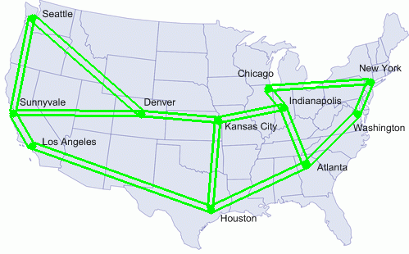
The Ghost of perfSONAR Past
Internet2 E2E piPEs (End-to-End Performance Initiatives Performance Environment System) ~2003/2004

Slide 19
Problem: Nobody’s Fault
Courtesy of E. Boyd @ Internet2
Hey, this is not working right!
Others are
getting in ok
Applications
Developer
Not our problem
Applications
Developer
LAN
Administrator
Talk to the other guys
LAN
Administrator
Everything is
AOK
System
Administrator
System
Administrator
Campus
Networking
Campus
Networking
The computer
Is working OK
No other
complaints
Looks fine
All the lights
are green
Gigapop
Gigapop
How do you solve
a problem along a path?
Everyone says it is
working fine!
We don’t see
anything wrong
Backbone
The network is lightly loaded
Notes:
No one claims that their cloud has a performance problem.
Note that a majority of the clouds are on campus

Slide 20
The Ghost of perfSONAR Past
GEANT2/JRA1 Framework Layers (~2004)

Slide 21
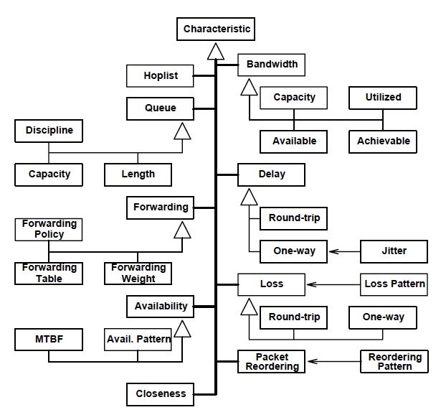
The Ghost of perfSONAR Past
Global Grid Forum (~2003)
Hierarchy of Network Performance Characteristics
http://www.ogf.org/documents/GFD.23.pdf
Request Schema Requirements and Sample Implementation
Report Schema Requirements and Sample Implementation

Slide 22
The Ghost of perfSONAR Past
~2004/2005
Merging the efforts of GGF/OGF, Internet2 E2E piPES, GN2/JRA1
“SONAR”: You could call it piPEs v2.0 (if you’re American) or GFD (if you’re European)
A Services-Based Measurement Framework for Building Dynamic, Self-Organizing Performance Communities
Added additional partners from ESnet and RNP
First release in ~2005
pS/MDM Offerings in ~2007
pS Performance Toolkit ~2009
~1000 Deployed Instances ~2013

Slide 23
Overview
Introduction
The Ghost of perfSONAR Past
perfSONAR Present
Use Cases
Future Directions & Unfinished Business

Slide 24
What is perfSONAR?
perfSONAR is a tool to:
Set network performance expectations
Find network problems (“soft failures”)
Help fix these problems
All in multi-domain environments
These problems are all harder when multiple networks are involved
perfSONAR is provides a standard way to publish active and passive monitoring data
This data is interesting to network researchers as well as network operators
Notes:
Enables Federation
Service oriented
Designed with ‘multi-domain’ in mind
Brings together useful tools to address different needs
Several active and passive tools
Interface to configure regular testing
Diagnostic tools ready with ‘0 configuration’
Easy to install, easy to use
ISO image can be burned to CD/USB key
‘Wizard’ interface for configuration
Encouraging people to deploy ‘known good’ measurement points near domain boundaries
“known good” = hosts that are well configured, enough memory and CPU to drive the network, proper TCP tuning, clean path, etc.
Community Adoption
Over 600 instances seen world wide as of early May
20+ countries
100s of domains

Slide 25
perfSONAR Toolkit
The “perfSONAR Toolkit” is an open source implementation and packaging of the perfSONAR measurement infrastructure and protocols from ESnet and Internet2
http://psps.perfsonar.net
All components are available as RPMs, and bundled into a CentOS 6-based “netinstall” and a “Live CD”
perfSONAR tools are much more accurate if run on a dedicated perfSONAR host, not on the DTN
Very easy to install and configure
Usually takes less than 30 minutes

Slide 26
perfSONAR Toolkit Services
PS-Toolkit includes these measurement tools:
BWCTL: network throughput
OWAMP: network loss, delay, and jitter
traceroute
Test scheduler:
runs bwctl, traceroute, and owamp tests on a regular interval
Measurement Archives (data publication)
SNMP MA – router interface Data
pSB MA -- results of bwctl, owamp, and traceroute tests
Lookup Service: used to find services
PS-Toolkit includes these web100-based Troubleshooting Tools
NDT (TCP analysis, duplex mismatch, etc.)
NPAD (TCP analysis, router queuing analysis, etc)

Slide 27
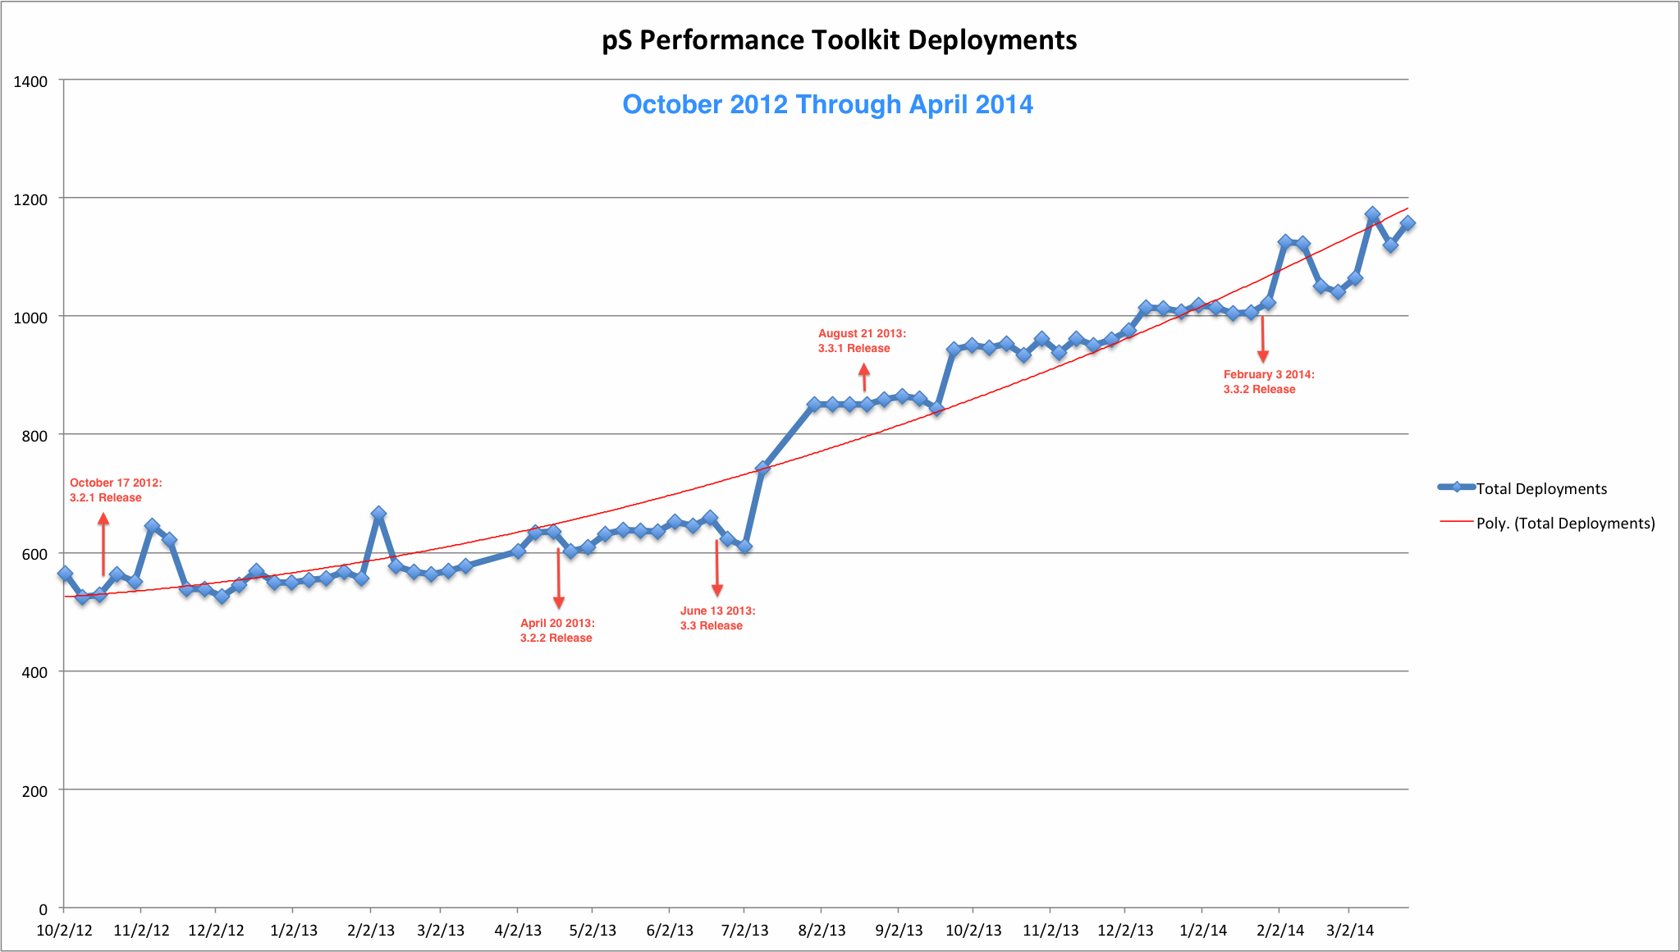
perfSONAR Present

Slide 28
Lookup Service Directory Search: http://stats.es.net/ServicesDirectory/

Slide 29
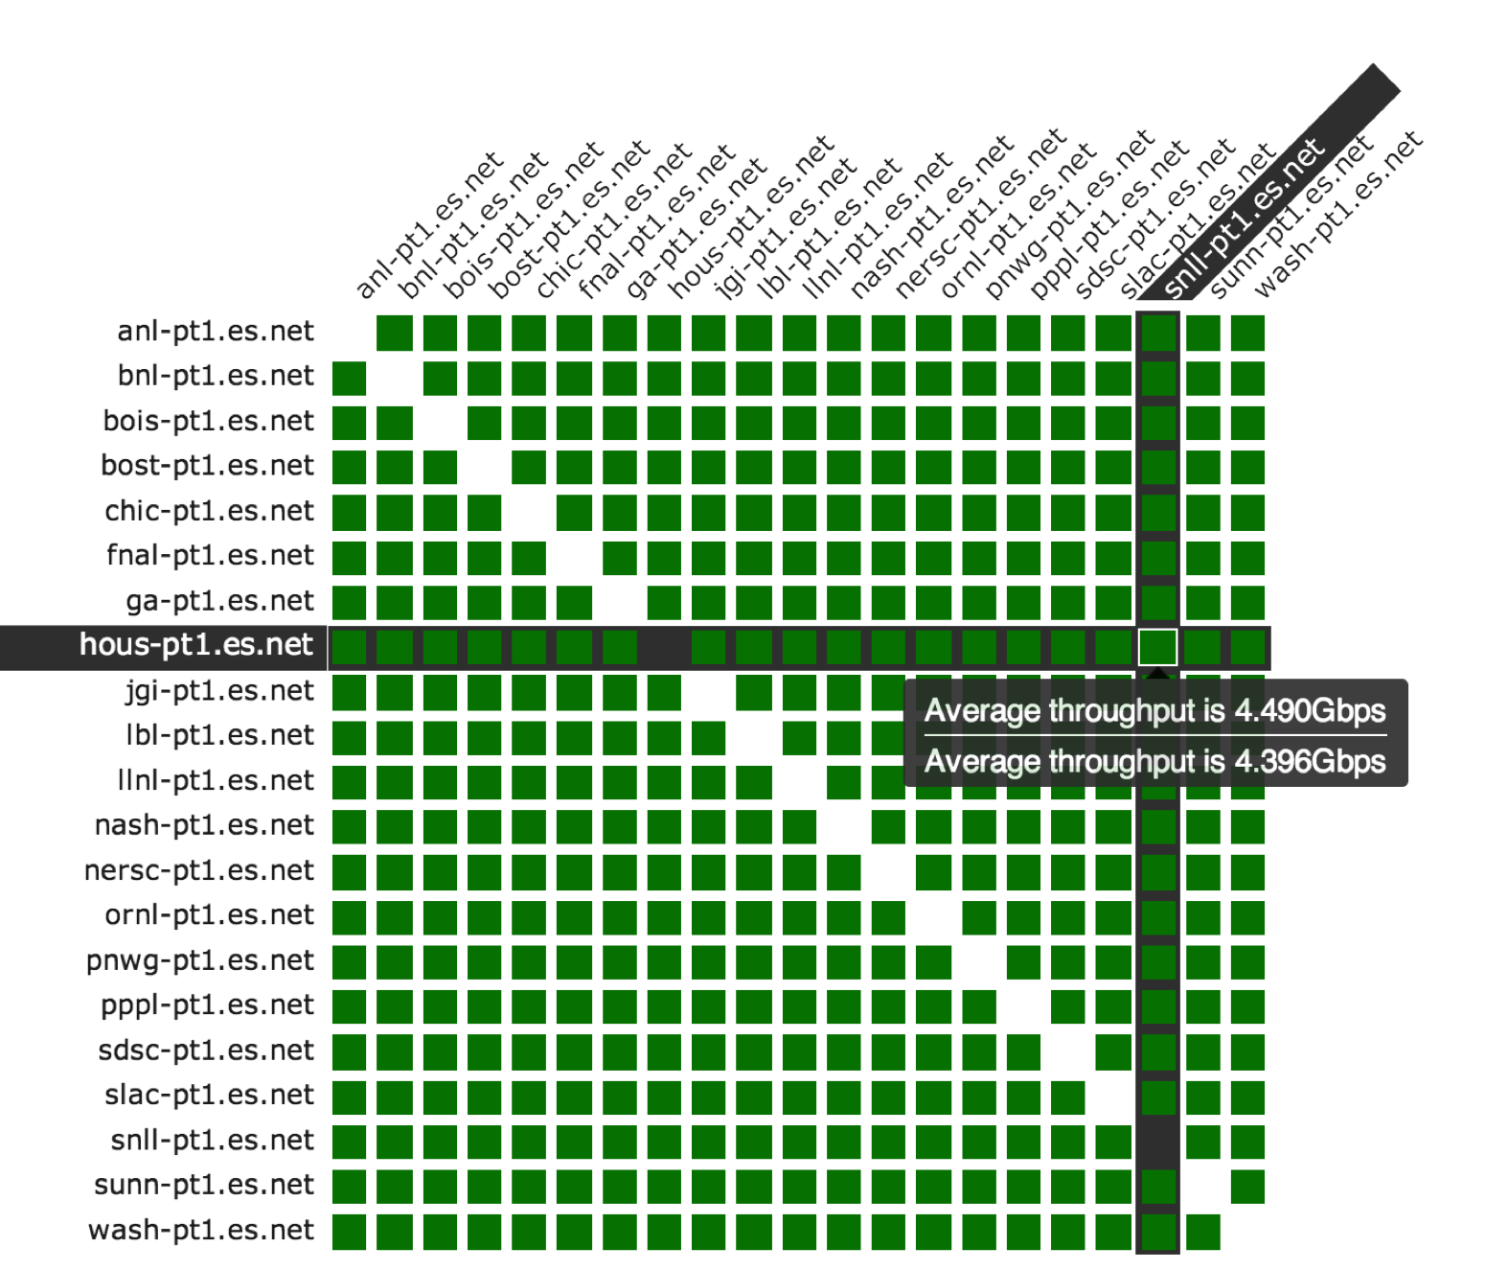
perfSONAR Dashboard: http://ps-dashboard.es.net

Slide 30
Overview
Introduction
The Ghost of perfSONAR Past
perfSONAR Present
Use Cases
Future Directions & Unfinished Business

Slide 31
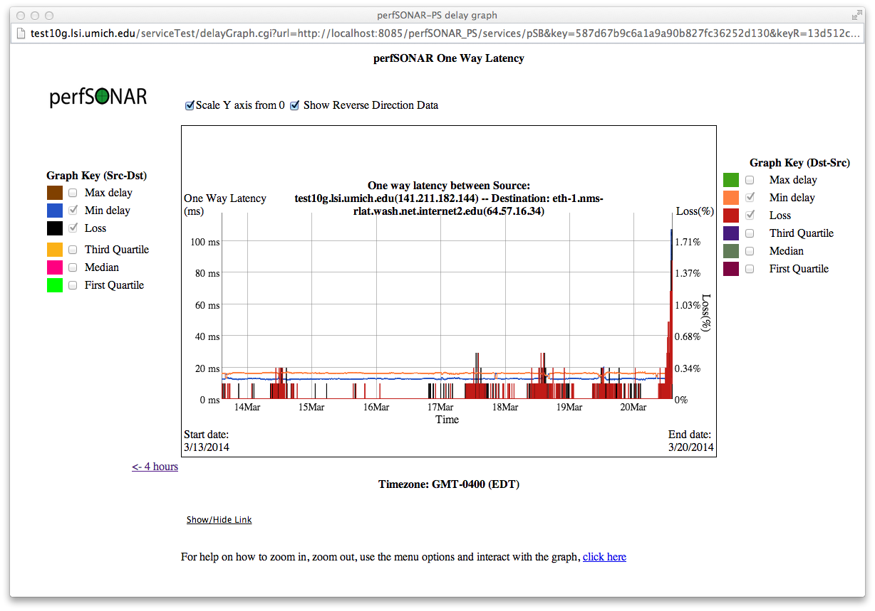
Congestion – via OWAMP Loss

Slide 32
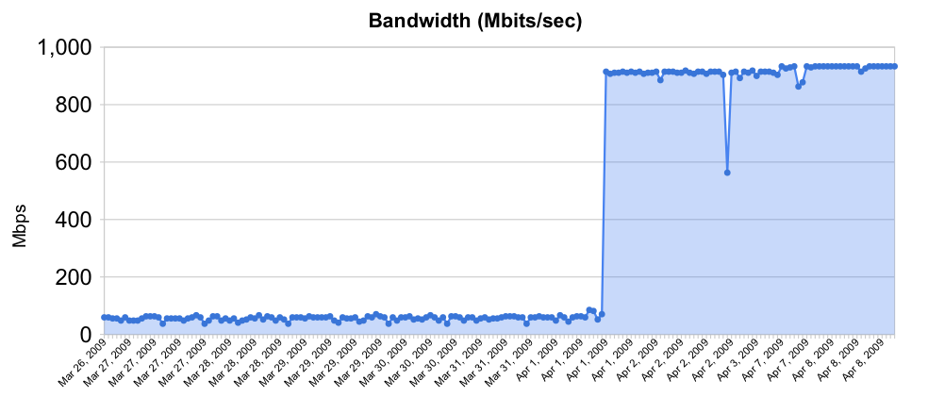
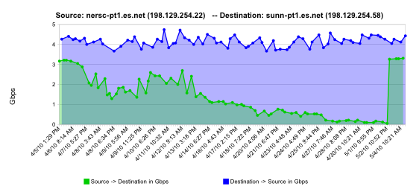
Soft Routing/Interface Failures
Rebooted router with full route table
normal performance
Gradual failure of optical line card
Gb/s
degrading performance
repair
one month

Slide 33
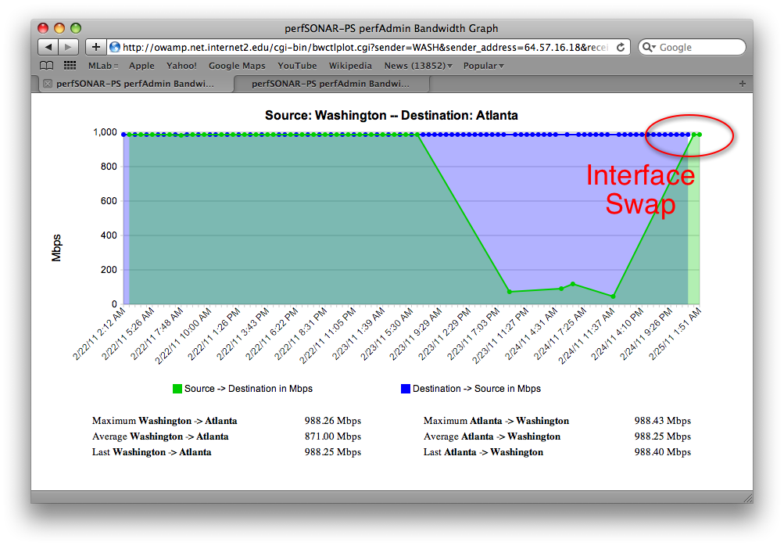
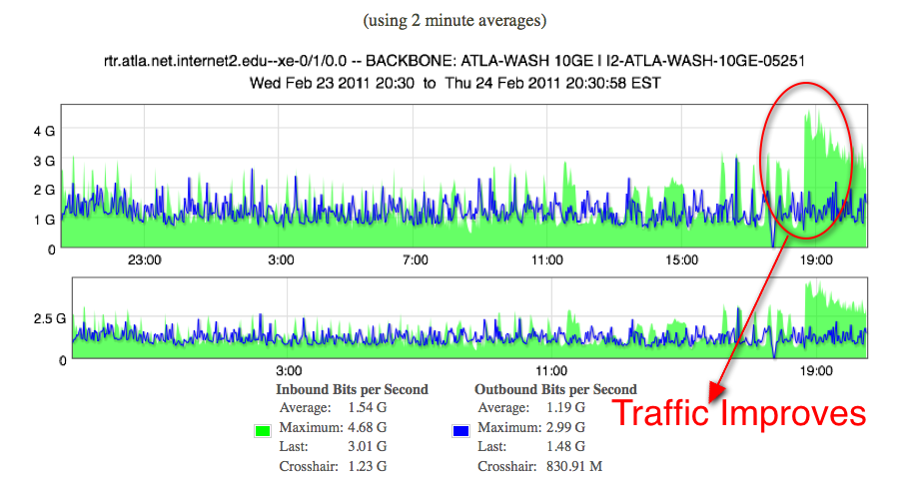
Failing Optics (BWCTL and Utilization)
Example taken from Internet2 backbone

Slide 34
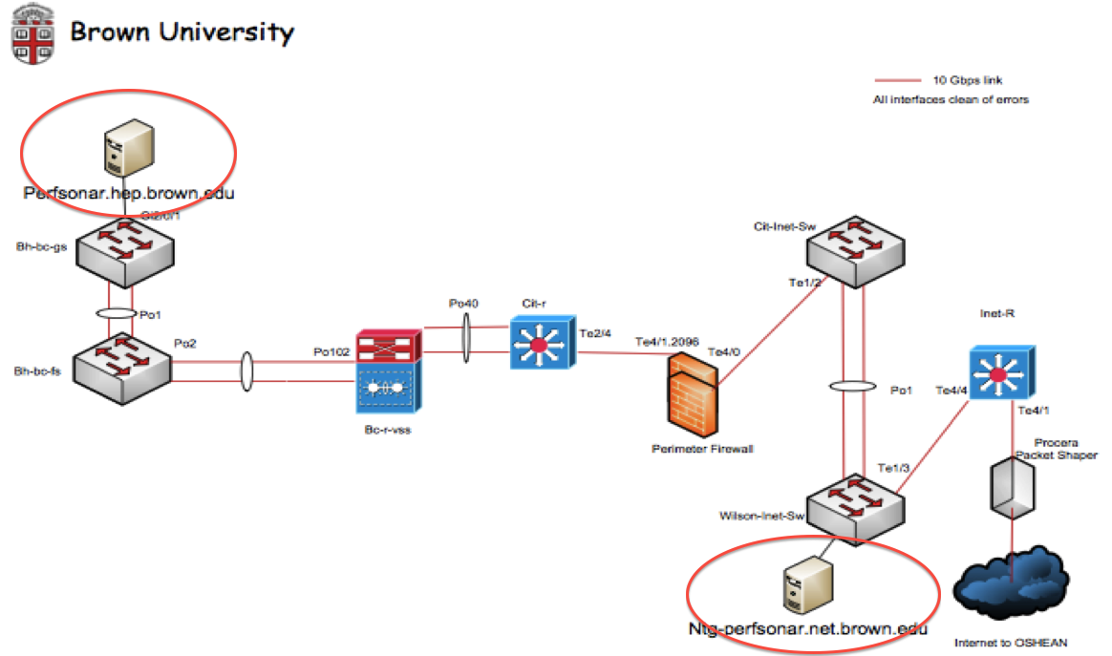
Firewalls
When used as a comparison tool – we can see that security devices are impacting performance
Powerful incentive to fix this in the scientific path

Slide 35
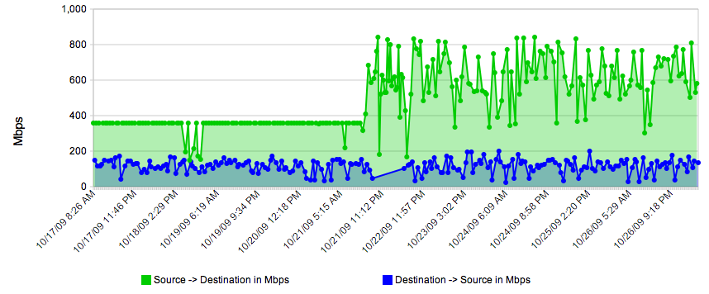
Host Tuning
Simple example – play with the settings in /etc/sysctl.conf when running some BWCTL tests.
See if you can pick out when we raised the memory for the TCP window

Slide 36
Overview
Introduction
The Ghost of perfSONAR Past
perfSONAR Present
Use Cases
Future Directions & Unfinished Business

Slide 37
Future Directions & Unfinished Business
Deployment
Installation via ISO/Live CD was the greatest catalyst for deployment. This brought measurement tools to the unsophisticated user
What does perfSONAR on a small appliance (cubox, Intel NUC, Raspberry PI) look like, and what do we need to do to support it?
Tools
There will always be new tools – the data abstraction supports sharing
SDN integration? How can monitoring data be used to fundamentally change networking protocols?
Use Cases
Designed by engineers for engineers – except when the Scientists and CEOs discovered what it can do
Can a simple web page be made that allows a live tests between anything in the world?
Could we get the same software used on the server, integrated into the routing device?
Adoption
Scaling to 1000+ instances was great – how can we scale to 10000? Greater emphasis on the project means more helpers needed

Slide 38
The perfSONAR Project at 10 Years: Status and Trajectory
Questions/Comments/Criticisms?
Jason Zurawski - zurawski@es.net
ESnet Science Engagement – engage@es.net
http://psps.perfsonar.net

