Slide 1
Cybersecurity: Protecting Against Things that go “bump” in the Net
Jason Zurawski – zurawski@es.net
Science Engagement Engineer, ESnet
Lawrence Berkeley National Laboratory
Southern Partnership in Advanced Networking
April 9th, 2015

Slide 2
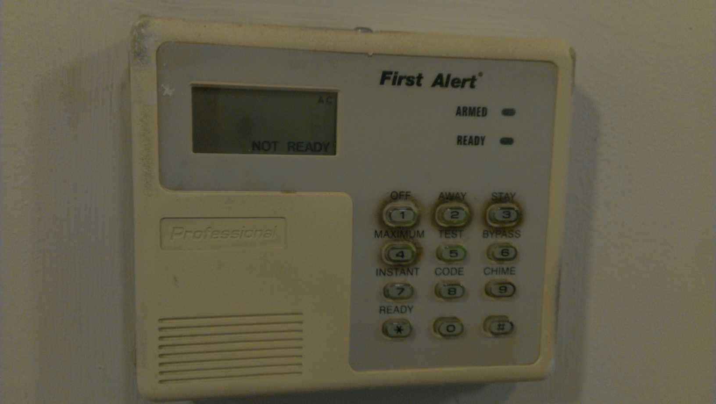
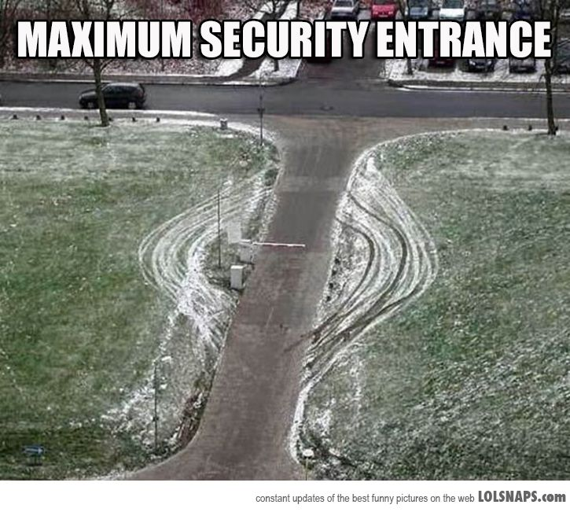
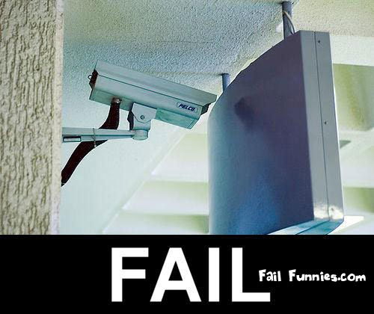

Slide 3
Outline
Introduction, Motivation
Terminology
Assessing Risk
Case Study – Science DMZ Security Posture
Conclusions

Slide 4

Introduction
Security = the degree of resistance to, or protection from, harm
  Many specific applications – we will deal with how this applies to computers, storage, data, and networks
Particle application:
  Being cognizant of the risks that are present
  Being knowledgeable of the mitigation strategies
  Being aware of the the implications after a strategy is employed to address a risk/risks
None of this is black and white:
  Security cannot be addressed with a single product/service
  Security for a campus is a system, and with any system it can get complex
    Layers, roles, responsibilities
Secure from whom? Secure against what?

Slide 5
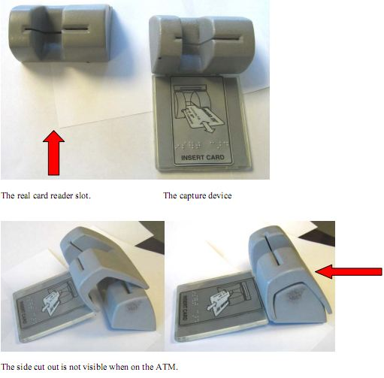
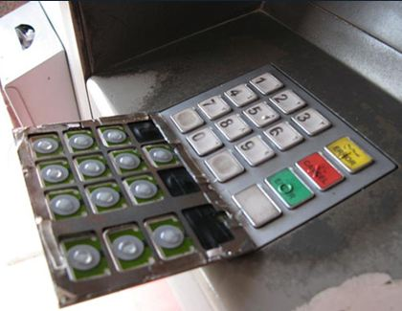
Physical Technology Breach - Skimmers

Slide 6
Motivation
Approaches that are commonly (and erroneously) taken in the cyber world:
  Everything is a risk – secure it all to the fullest extent!
  Our purchase of X makes us safe, problem solved!
    N.B. Hopefully this doesn’t describe any recent vendor interactions you had …
  The chances of something bad happening are low, there is no real risk for what we are doing
  The costs of securing are too high/the costs of a cleanup are relatively low
    N.B. Target, or any of the other breaches in the last 12ish months.

Slide 7
Motivation
A fact to be aware of: attackers have a mathematical advantage in cyber scenarios
  Attacking computers with computers impies automation
  Attack surface (targets, opportunities) is large
Sutton's Law: when diagnosing, one should first consider the obvious
  E.g. Willie Sutton supposedly* robbed banks because “that's where the money is”
  There are many obvious things that can and should be secured.
  There are also many obvious solutions that are widely available – degree of difficulty may vary
*Later proven untrue, by Sutton himself - http://www.snopes.com/quotes/sutton.asp

Slide 8
Outline
Introduction, Motivation
Terminology
Assessing Risk
Case Study – Science DMZ Security Posture
Conclusions

Slide 9
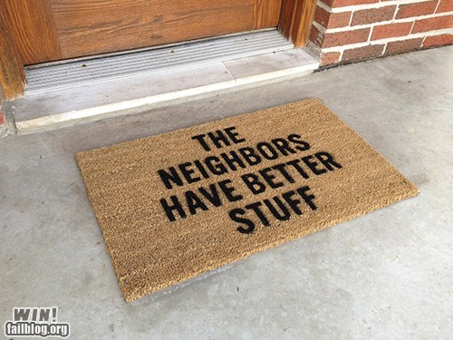
Terminology
There are many threats – most can be broken into 3 categories:
  Criminal: Violation of national/international law
  Privacy Breaches: Gathering of personal/organizational data for unintended uses
  Attention Generating: Ways to generate wanted/unwantted publicity to the attacker or target
Some attacks may end up hitting all three buttons

Slide 10
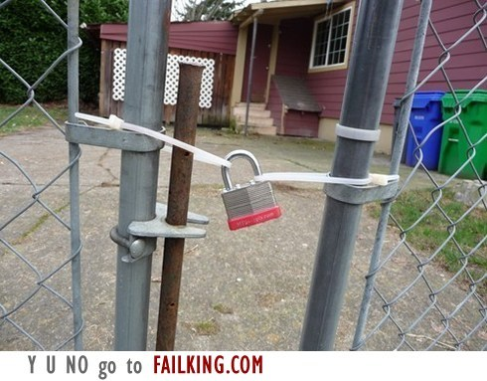
Criminal Threats
Fraud – Misrepresentation
Scams – Normally a front to gather personal information or other criminal mischief. Think phishing, etc.
Destruction of Property – destruction of equipment, data. Preventing access to resources and the costs associated
Intellectual Property Theft – Espionage to steal national/trade secrets.
Identify Theft – Privacy breaches that target a person, persons, or entities
Brand Theft – misrepresentation of a person/entity that can lead to other ramifications

Slide 11
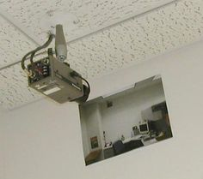
Privacy Violations
Data Harvesting – Using automated means to gather information (PII – Personally Identifiable Information) about people/entities. Normally done through attacks on non-public sources (databases, unsecured locations with non-encrypted records)
Surveillance – Monitoring the electronic transmissions between entities. Those most at risk will be using un-encrypted communication patterns.
Traffic Analysis – Examining the flow of traffic between entities to determine patterns in activity (e.g. when remote backups may occur, to which locations, and any clues about the protocols being used).

Slide 12
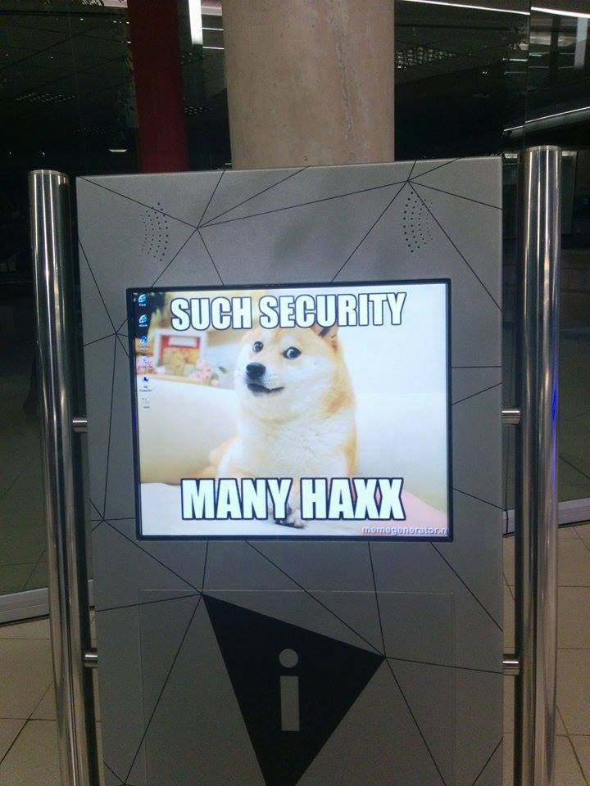
Attention Generators
DoS/DDoS – Attacks from a source, or many sources, to reduce the ability of the target to function. Simply stated – overwhelming a destination with traffic so that it can no longer handle legitimate operations.
Publicity
  Taking credit for a large scale attack to draw attention to a cause.
  Attacking a target to show it’s relative insecurity and non-reliability, perhaps to highlight a competitor

Slide 13
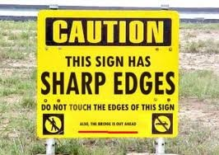
Security Needs
There are several base needs we want to establish, each with a different definition and relative cost for securing.
Not all of these are important for every campus.
Some matter more to end users versus the campus infrastructure

Slide 14
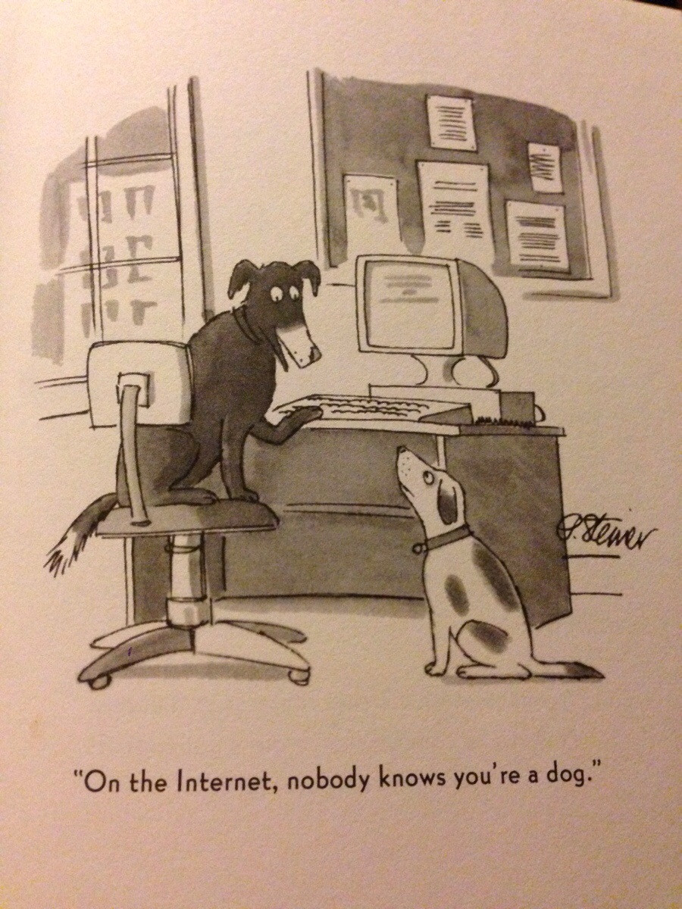
Security Needs
Privacy – Everyone wants this, but there is a cost associated. Not everyone is willing to pay to achieve this
  Think back to Target – it’s expensive to upgrade 1000+ locations to ensure that there is no leakage of PII at the POS terminal. Its also expensive to give free credit monitoring to everyone after the fact. Did anyone ‘win’ in this scenario?
“Layered” Security – Ex: US government information classification system (confidential, classified, secret, top secret, etc.). Allows for a graduated curve based on risk.
Anonymity – Ability to track the actions of a person/persons/organization versus the desire of those actors to not be tracked.
  Fine line between surveillance and anonymity

Slide 15
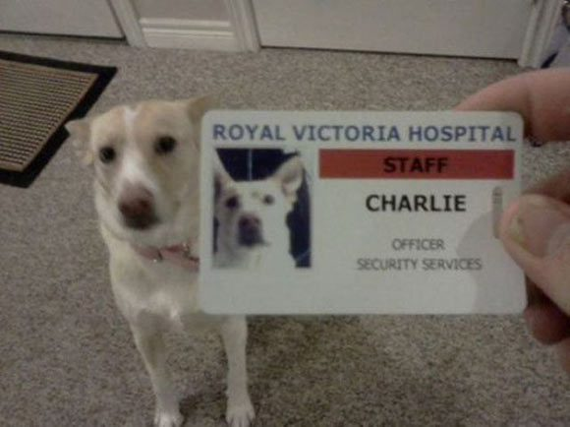
Security Needs
Authentication – The ability to verify who you say you are (e.g. this is a ‘continuation of trust’ from the physical world)
Authorization – Works hand in hand with the above, but not the same. This is being able to check that your identify can do what it is asking to do.
Integrity – Related to both items above – but not the same.
  Integrity is the validation of data. E.g. if someone modified some file, does it remain in the correct state until it is accessed/modified again.
  Also not ‘accuracy’, that is a material world concept. Integrity is measured against itself over time.
Auditing – The process of verifying the correctness of a system

Slide 16
Outline
Introduction, Motivation
Terminology
Assessing Risk
Case Study – Science DMZ Security Posture
Conclusions

Slide 17
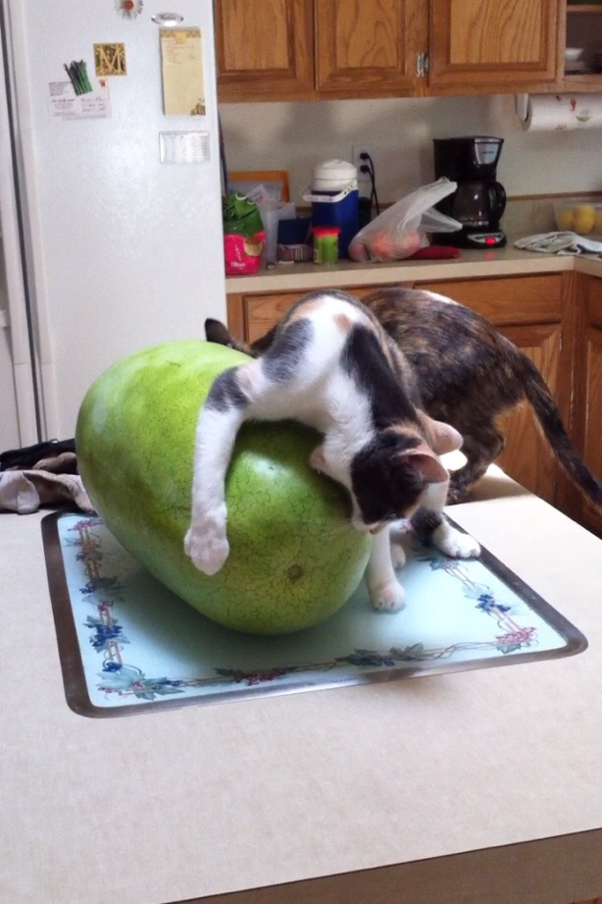
Assessing Risk
Large Task – but you can bite it off and chew it
Breaking this down into the risks to the 3 major portions of the cyber world:
  Data
  Computing Infrastructure
  Network Infrastructure

Slide 18
Assessing Risk - Data
Simple goal: protecting data from destructive forces, and from the unwanted actions of unauthorized users
PII (personally identifiable info)
  Information that can be used on its own or with other information to identify, contact, or locate a single person, or to identify an individual in context
  Master class of things like PHI (health information)

Slide 19
Assessing Risk - Data
The first step in addressing this – is to know what you want to protect. A typical campus may have:
  Student/Staff records containing PII (SSN, DOB, bank information, health records, grades)
  Research data (patents, original research work, NDA’ed joint work, grant information, human subjects)
  Software licenses
Could/should all of this be treated the same way?

Slide 20
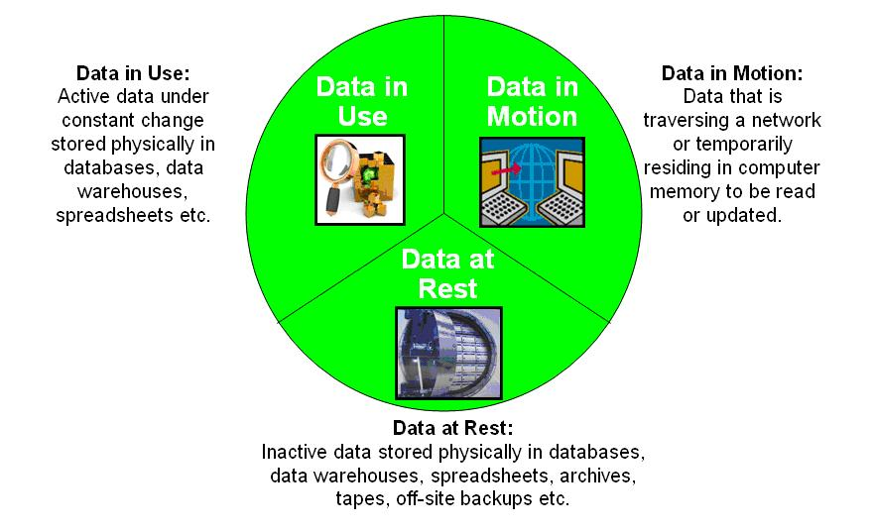
Assessing Risk - Data
The data lives in 3 major states:
How does the motion impact the security approach?

Slide 21
Assessing Risk - Data
Common Approach
  Identify the risks to the data itself, e.g. PII cannot/should not remain at rest without some form of encryption. This will protect it from a machine breach. If it has to go in motion, encrypting the communication channel is also recommended.
  Most day to day activities that are not PII (e.g. web browsing, mail) may not be important enough to secure
    Remember the discussion on layers of security
  Not all research data is created equal – talk to the researchers about this.

Slide 22
Assessing Risk - Data
Research Data
  Imagine a climate scientist – they download a lot of observation data from collaborators. When they are done, they normally delete it. What needs to be secured?
  The data itself has 2 portions:
    Metadata: information on where/when it was gathered. Could be PII (e.g. you should ask)
    Data: time/value pairs. Without the metadata, this is basically worthless. Is there a way to tie it back? Is the metadata PII?
  Protection strategy:
    Protect the metadata at rest/in motion
    Data can be given a pass on protections depending on how it relates back to metadata

Slide 23
Assessing Risk – Computers/Storage
There are physical and electronic risks to any form of computational device:
  Unauthorized access (local and remote)
  Loss of connectivity (local and remote)
  Corruption of storage
  Vessel for delivery of other threats (surveillance, propagating malicious software)
As in the case of data – know the use cases/risks before approaching this topic
  Solutions are not one size fits all

Slide 24
Assessing Risk - Networks
The risks to networks are an extension of the risks to computers themselves
  E.g. worm propagation causes traffic
  Distributed attacks overwhelm the network path, as well as the end host
Some risks to be aware of:
  DNS/Route Highjacking
  URL Squatting
  DoS/DDoS
  Malware attaching routing/switching devices

Slide 25
Outline
Introduction, Motivation
Terminology
Assessing Risk
Case Study – Science DMZ Security Posture
Conclusions

Slide 26
Myths about the Science DMZ
“ESnet invented high-performance networking.”

Slide 27
Myths about the Science DMZ
“ESnet invented high-performance networking.”
FALSE: Smart people in our community have been doing high-performance networking for years. ESnet examined the practices that were effective, and generalized them into a replicable model. That model is the Science DMZ. ESnet developed the integrated Science DMZ concept, but many of the practices came from the community.

Slide 28
Myths about the Science DMZ
“ESnet invented high-performance networking.”
FALSE: Smart people in our community have been doing high-performance networking for years. ESnet examined the practices that were effective, and generalized them into a replicable model. That model is the Science DMZ. ESnet developed the integrated Science DMZ concept, but many of the practices came from the community.
“The purpose of a Science DMZ is to get around or avoid firewalls and other security controls.”

Slide 29
Myths about the Science DMZ
“ESnet invented high-performance networking.”
FALSE: Smart people in our community have been doing high-performance networking for years. ESnet examined the practices that were effective, and generalized them into a replicable model. That model is the Science DMZ. ESnet developed the integrated Science DMZ concept, but many of the practices came from the community.
“The purpose of a Science DMZ is to get around or avoid firewalls and other security controls.”
VERY FALSE: The purpose of the Science DMZ is to match controls (security and otherwise) with the actual thing that’s being protected, while maximizing the particular functionality of the network (in this case, data transfer). As such, the Science DMZ is a security architecture: The separation afforded by the Science DMZ allows finer-grained security controls tailored to the specific risks present in different parts of the network.

Slide 30
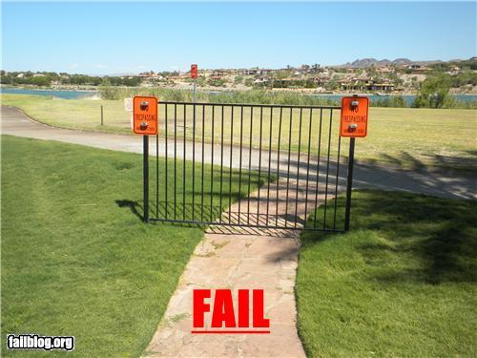
Science DMZ Security Model
Goal – disentangle security policy and enforcement for science flows from security for business systems
Rationale
  Science flows are relatively simple from a security perspective
  Narrow application set on Science DMZ
    Data transfer, data streaming packages
    No printers, document readers, web browsers, building control systems, staff desktops, etc.
  Security controls that are typically implemented to protect business resources often cause performance problems
Notes:
Note that in the diagrams the security policy control mechanisms are part of the Science DMZ switch/router

Slide 31

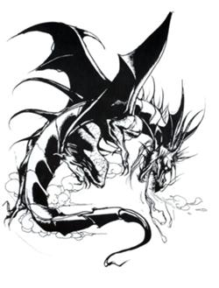






IDS, Flow,
Security data collectors
Notes:
Common campus type deployent. There may already be some one-off DMZ services but majority of traffic flows through a security appliance or set of devices of some sort. This will likely remain but the addition of a Science DMZ will add a “fast path” into the network that bypasses these typical filtering mechanisms.

Slide 32

IDS, Flow,
Security data collectors
Science Image from http://www.science.fau.edu/
Notes:
Example of a basic science DMZ. A fast path out for scientific and other research traffic. However…This is what a security engineer doing his due diligence is going to look at it like this, and that’s a good thing

Slide 33


IDS, Flow,
Security data collectors
Notes:
Practically speaking, this is a well monitored network from a 20,000 foot view. Note the optical tap on the science DMZ link. This could easily be a series of optical taps, gigamon devices, arista switches, cpacket devices or a series of span ports. The mechanism is less important the the function, and each have advantages.

Slide 34
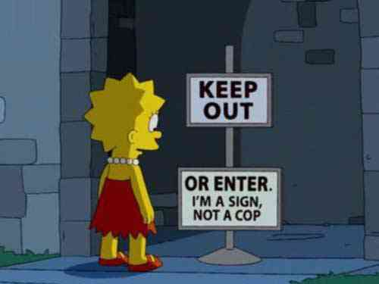
How does your existing security work?
Perimeter Security
Patch Scheduling
Host integrity
Data assurance
Accountability
Action
Notes:
How does your existing security work? Why recreate the wheel when you really don’t need to. We want to reduce, reuse and recycle. Adding as much visibility as is reasonable in a given environment. We may remove the lock on the door but we scrutinize the parties going through it.

Slide 35
How does your existing security work?
Perimeter Access Control – e.g. keep what should be in, in; keep what should be out, out.
  Use non-stateful methods – state takes time to maintain; that can cause bottlenecks
  Block access to control plane
    SNMP, SSH, telnet(!) access to management interfaces
    ACL things that should never traverse that path, LPR, SNMP access from external entities, inbound telnet, MS ports, etc.
    Close off loopbacks
  Better still – use a bastion network/host with the above suggestions
Limit exposure (reduce surface area)
  Routing is the ‘hammer’ in your toolbox - don’t need to announce the *entire* address space of your institution to a given resource. Announce only smaller prefixes in the DMZ
  Helps to pace out what the IDS will see too

Slide 36
How does your existing security work?
Software Patching & Configuration Management
  “Early and often” – it is folly to try to manage this by hand. Use an automated solution
  Central management (cfengine, puppet, etc.) is not just for clusters anymore. Helps with security, also helps with user management, etc.
Host-Based Security
  IDSs - Not a replacement for a good perimeter IDS; good at specific jobs (e.g. malware detection [rkhunter], installation of packages/user behavior [tripwire], breach monitoring [fail2ban]). Others (OSSEC) handle a lot more tasks and branch out into log-watching capabilities.
  Firewalls - On a host, these act as the ‘second wave’. Can be tuned to a finer grain than perimeter ACLs or a blanket firewall – e.g. the DTN needs different ports than perfSONAR, but both want to restrict SSH access to a bastion host

Slide 37
How does your existing security work?
User Accountability
  Central user management is a great tool to manage the who/what/where aspects
  Bastion host can limit the attack surface for resources
Logging (& alerting)
  Need a way to aggregate behavior on servers/network devices and look for patterns
  Lots of software solutions to help here (logstache, graywolf, splunk)
Confidentiality & Data Integrity
  Easy win – secured protocols (e.g. SSH) when you need them.
  Deep thoughts – what data are your scientists sending? Is it PHI?
    Yes – encrypt at rest using a strong protocol. Use an encrypted channel (not SCP – most data transfer can do encryption, e.g. Globus)
    No – can stull use an encrypted channel, but this is a waste of CPU resources
  Check-summing the end result

Slide 38
How does your existing security work?
External IDS
  Heavy hitter on the network – ideally will be doing real-time processing of traffic without impacting flows: does this via use of optical taps/port mirroring
  Bro-IDS, Snort, Surricata, etc – assess before choosing
Dynamic black hole routing
  Idea is to send traffic identified to be nasty to the bit bucket. The IDS can be programmed to help with this – or by subscribing to community feeds
  BGP FlowSpec (RFC 5575)
    Relatively new protocol that defines a new BGP NLRI (Network Layer Reachability Information) format used to distribute traffic flow specification rules.
    E.g. selective drop traffic similar to how a firewall would work
    Very new and requires a lot of care and feeding - Caveat emptor

Slide 39
IDS, Flow,
Security data collectors
X
Black Hole Router
Notes:
The mechanics of this are that your blackhole router will push out an update to your border routing devices and they will operate as fast as the network hardware can insert and withdraw prefixes.
At a basic level, the remote triggered black hole router functions like this: Nefarious traffic appears, anomaly detected by IDS system. It signals the black hole router which sends a BGP update to the science DMZ router that then blocks the traffic using the policy configured for that peering.
The limiting factors are the resources associated with the routing table size on the platform and the fact that it can only block at layer 3, so no port level blocking with standard BGP black hole routing. Address only.

Slide 40
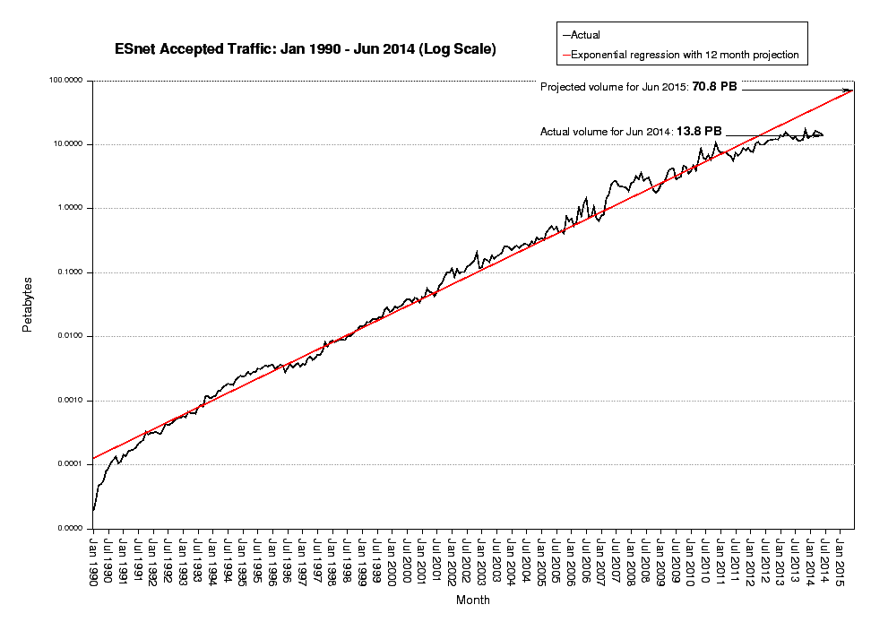
Other Considerations
Baselines Matter
  Traffic graphs
  Flow Data
  Syslog (host and network)
Notes:
You have your tools for blocking and your heavy machinery for identifying undesirable traffic. Baselines are critically important from the perspective of identifying anomalies. What baselines will provide is a great visual cue for anomaly detection.
Again, your networking team likely already has a mechanism for recording this information, the Science DMZ just needs to be included. Some platforms even allow for alerting on deviations from baselines.

Slide 41
Other Considerations
Don’t forget IPv6 (because you are dual stacked … right?)
  Treat this as a parallel attack vector – perhaps one that hasn’t been considered
SDN
  The hype curve on this technology may outpace what is possible security wise
  At a minimum, consider the implications of data plane/control plane separation, and what risks that will impart if there is a failure (natural, or caused)
Organizational Buy In
  Security = a system. No single shot tool, not one person/groups job
  Every part of the org needs to sign off and be a part of the solution

Slide 42
Outline
Introduction, Motivation
Terminology
Assessing Risk
Case Study – Science DMZ Security Posture
Conclusions

Slide 43
Conclusions
Hard stuff
No single solution
Have a plan (!) – planning involves knowing the risks, mitigation strategies
Science DMZ specifics:
  Separation of functions (resulting in good network segmentation) is key.
  A well-designed Science DMZ is a security architecture.
  The Science DMZ improves risk mitigation.
  The Science DMZ is not a security workaround, it is the solution.

Slide 44
Cybersecurity: Protecting Against Things that go “bump” in the Net
Jason Zurawski – zurawski@es.net
Science Engagement Engineer, ESnet
Lawrence Berkeley National Laboratory
Southern Partnership in Advanced Networking
April 9th, 2015

Slide 45
Extra Slides

Slide 46
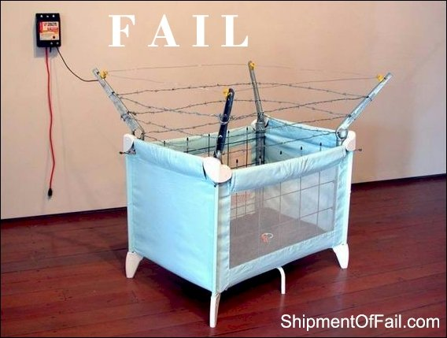
Assessing Risk – Computers/Storage
Protections we desire:
  Privacy: only people who should be allowed in, are allowed in
  Integrity:
    Data remains in the state that the last authorized user modified it
    Data not being deleted/modified without permission
  A way to audit/track movements on resources
Things that want to break our desires:
  Malware
  Spyware
  Ransomware
  Worms
  Viruses

Slide 47
Assessing Risk – Computers/Storage
Malware
  portions of code, normally installed as a part of legitimate software
  Goal is to disrupt system operation
  Typically a front for other behavior (e.g. gathering data, inserting advertising where it shouldn’t be, modifying the way other software behaves
  Modularity of operating systems/applications makes this a problem that will never go away
Spyware
  A variety of malware that focuses on the collection of data, almost always without the consent of the owner
  Designed to run in the background – hard to detect
  Masks the operation of the host to prevent detection

Slide 48
Assessing Risk – Computers/Storage
Ransomware
  Gaining some traction, a piece of malware that ‘holds you hostage’.
  Normally will steal/encrypt your information so that you don’t have access. Remote attackers will demand a payout to unlock.
Worms
  Self-propagating code that infects computers (normally over a network – sometimes over sneakernet) that are unprotected
  Generates traffic, and features one of the other forms of malware in many cases
Viruses
  Infections that are designed to cease operation of hardware/software. Can propagate over networks, and attached to other media (mail attachments, etc.)

Slide 49
Assessing Risk - Networks
DNS Highjacking
  To a certain extent – this happens ‘legitimately’ (e.g. your home ISP may manipulate requests in order to send traffic to a CDN, or insert ads)
  Malware redirecting DNS requests to a different server
Route Highjacking (attack by itself, also a means to an end)
  AS announces it is origin for prefix falsly
  AS announces a more specific prefix than the true origin
  AS announces a shorter route for some prefix than what is available
  RPKI as a possible solution
URL Squatting
  Banking on the spelling/logic/intention mistakes of everyone
    http://www.gooogle.com
    http://www.school.net
    http://www.cablenewsnetwork.co.uk

Slide 50
Assessing Risk - Networks
DoS/DDoS
  Coordinated attacks designed to take out a network or host – e.g. send a lot of TCP SYN packets. Easy to code run.
  Made infinitely easier with the advent of cloud computing – an attacker can buy many cloud instances and install their software of choice
  Can do it the old fashioned way too and make/buy a botnet of infected machines around the globe
    Gaming systems are a popular target now
Malware attaching routing/switching devices
  Emerging trend – taking advantage of software vulnerabilities and default configurations

